Slide 1
Metallic bonding

Slide 2
The third kind of bonding you are expected to know about is metallic bonding:
4.4.1: Describe the metallic bond as the electrostatic attraction between a lattice of positive ions and delocalized ions.
4.4.2: Explain the electrical conductivity and malleability of metals.

Slide 3
Metallic bonding happens between atoms which all have low electronegativities.
Not surprisingly, this means metal atoms!
Atoms which have low electronegativities don’t attract electrons very strongly
So the valence electrons aren’t held tightly and are free to move around.
They are delocalised.

Slide 4
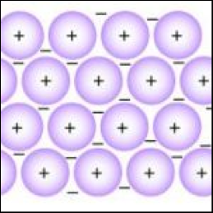
This leaves positive metal ions surrounded by delocalised electrons.
Many books talk about a “sea of electrons”
Valence electrons

Slide 5
It is the electrostatic force between the positive ions (cations) and the sea of electrons that holds the metal together.
Because the electrons can move, layers of cations can slide past each other.
This makes metals malleable and ductile.

Slide 6
The movement of the electrons allows metals to conduct both electricity and heat.
Additionally it is the way that the electrons interact with light that makes metals sparkly and silver!!

Slide 7
Question
Explain why group I metals have lower melting points than group II metals.
We’ve already done this!!
Group II metals have twice as many valence electrons, and the cations have twice the charge!

Slide 8
OK, so remind me why the melting point decreases as we go down group I (or group II)
The valence electrons that hold everything together are further from the positively charged nuclei.

Slide 9
Alloys

Slide 10
An alloy is a mixture of two or more metals, or a mixture of metal with carbon.
Alloys still show metallic properties, but are often less malleable and less ductile.
This is because introducing a different sized atom into the lattice of positive ions, stops the layers sliding past each other.

Slide 11
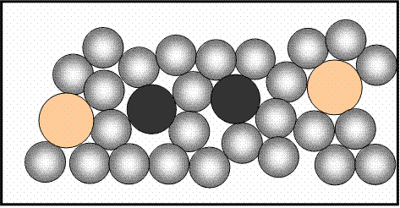

Slide 12
We will study a number of alloys in more depth when we cover Chemistry in Industry and technology

