Slide 1
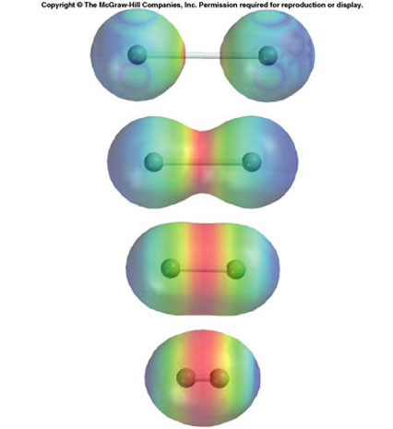
Bonding

Slide 2
Topics for study
4.1 Ionic Bonding
4.2 Covalent Bonding
4.3 Intermolecular Forces
4.4 Metallic Bonding
4.5 Physical Properties

Slide 3
It will help you a lot if you read through your notes from IGCSE.
There seems like a lot in this topic, but you know most of it already.
Honestly!

Slide 4
Q. Describe in detail the common reactions of group VIII elements.
There aren’t any!
The noble gases (He, Ne, Ar, Kr, Xe and Rn) are in Group VIII
They are all unreactive.
Their electronic structure appears to make them stable
They have a full ‘outer shell’ of electrons
Atoms without the electronic structure of a noble gas try to get one
Various ways are available

Slide 5
Ionic Bonding
4.1.1: Describe the ionic bond as the electrostatic attraction between oppositely charged ions.
4.1.2: Describe how ions can be formed as a result of electronic transfer.
4.1.3: Deduce which ions will be formed when elements in groups 1,2,3 lose electrons.
4.1.4: Deduce which ions will be formed when elements in groups 5,6, and 7 gain electrons.
4.1.5: State that transition elements can form more than one ion.
4.1.6: Predict whether a compound of two elements would be ionic from the position of the elements in the periodic table or negativity values.
4.1.7: State the formula of common polyatomic ions formed by non-metals in periods 2 and 3.
4.1.8: Describe the lattice structure of ionic compounds.

Slide 6
Ionic bonding is probably the simplest kind of bonding to understand
Ionic bonding occurs between an atom with low electronegativity and an atom with high electronegativity.
i.e. A metal!

Slide 7
Almost all metal compounds are ionic
Can you think of any exceptions?
Ionic bonding occurs when there is a large difference in electronegativities between the atoms involved
(that’s in yellow because I expect you to remember it!)
(which doesn’t mean you can forget everything else!)
Metal atoms lose one or more electrons from their outer shell (valence shell) to form a positive ion (cation) with the same electronic structure as a noble gas (isoelectronic with a noble gas)

Slide 8
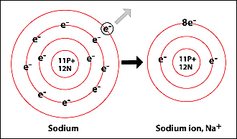
E.g Sodium atom Na 2,8,1
Loses one electron to form
Sodium ion Na⁺ 2,8
Which is isoelectronic with neon

Slide 9
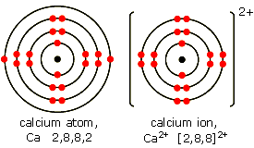
Calcium atom Ca 2,8,8,2
Loses 2 electrons to form
Calcium ion Ca²⁺ 2,8,8
Which is isoelectronic with Argon

Slide 10
For s-block elements it is easy to predict the charge on an ion
They lose their valence electrons
They have one positive charge for each electron they lose.
Groups I and II
The electrons in the outer shell

Slide 11
For d-block elements it is harder to predict the charge of any ion formed, because they can form a variety of different positive ions.
For SL chemistry you only need to know a few of these ions.
E.g. Fe²⁺ is iron(II)
Fe³⁺ is iron (III)
The number in brackets is called the “oxidation number”
You will learn more about these next year – but really all they do is tell you the charge on the ion!
Transition metals

Slide 12
Non – metals need to gain electrons to fill their outer shell and become isoelectronic with a noble gas.
Non-metals form negative ions.
They gain one negative charge for each electron they gain.
Negative ions are called anions

Slide 13
Remember
Negative ions are anions
Positive ions are cations

Slide 14
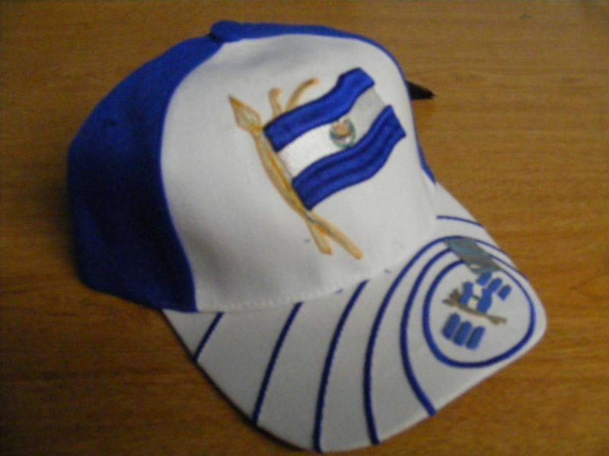
CAP – Cations are Positive

Slide 15
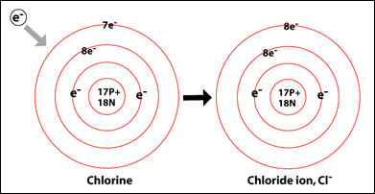
Chlorine atom Cl 2,8,7
Gains 1 electron to form
Chloride ion Cl- 2,8,8
Which is isoelectronic with argon

Slide 16
In making simple ionic compounds, we can consider that electrons are transferred from the metal to the non-metal.
Ionic compounds should have no overall charge – the positive and negative charges should cancel out.
This is how we work out the formula of ionic compounds.
Note that in the formula, the cation is given first.

Slide 17
Sodium atom needs to lose one electron
Chlorine atom needs to gain one electron

Slide 18
One electron is transferred from the sodium to the chlorine
Notice the charges on the two ions
1+ and 1- cancel each other out

Slide 19
A magnesium atom needs to lose 2 electrons
A chlorine atom can only gain one electron
So 2 chlorine atoms are needed to accept the electrons from one magnesium

Slide 20
Notice the charges on the ions
2 ions with 1- are needed to cancel out 1 ion with a charge of 2+
The formula of magnesium chloride is MgCl₂

Slide 21
Some simple questions!
Without looking up what each element is (!), predict the formula of the compound formed from elements A and B:

Slide 22
Electron configuration of A | Electron configuration of B | Formula of compound
2,1 | 2,8,7
2,6 | 2,8,8,2
2,8,1 | 2,8,6
2,8,3 | 2,7
2,5 | 2,8,2

Slide 23
Electron configuration of A | Electron configuration of B | Formula of compound
2,1 | 2,8,7 | AB
2,6 | 2,8,8,2 | BA
2,8,1 | 2,8,6 | A₂B
2,8,3 | 2,7 | AB₃
2,5 | 2,8,2 | B₃A₂

Slide 24
As well as ions containing a single element, there are a number of common ions that contain more than one element!
The other element is often (usually??) oxygen
E.g. Sulfate SO₄²⁻
Learn all these:

Slide 27
Give the formula of:
Potassium Bromide
Lead (II) Nitrate
Sodium Sulfate
Ammonium Phosphate
Chromium (III) Sulfate
Aluminium Hydride

Slide 28
Give the formula of:
Potassium Bromide KBr
Lead (II) Nitrate Pb(NO₃)₂
Sodium Sulfate Na₂SO₄
Ammonium Phosphate (NH₄)₃PO₄
Chromium (III) Sulfate Cr₂(SO₄)₃
Aluminium Hydride AlH₃

Slide 29
Ionic lattice structure
Ionic compounds are held together by the electrostatic attraction between the oppositely charged ions.
These forces act in all directions, so the compound exists as a 3-dimensional lattice structure

Slide 30
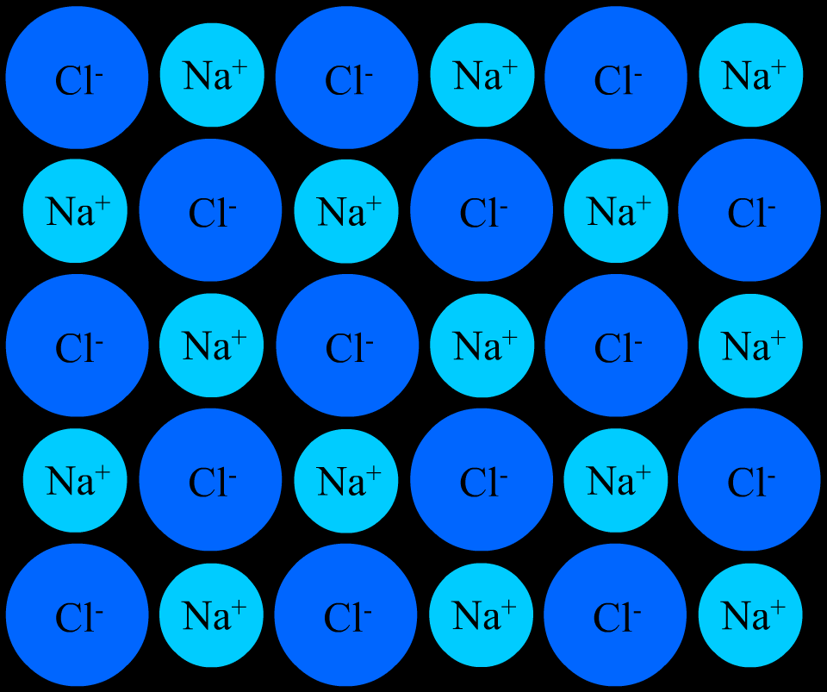
One layer of the lattice
+ve ions are surrounded by –ve ions and vice versa!

Slide 31
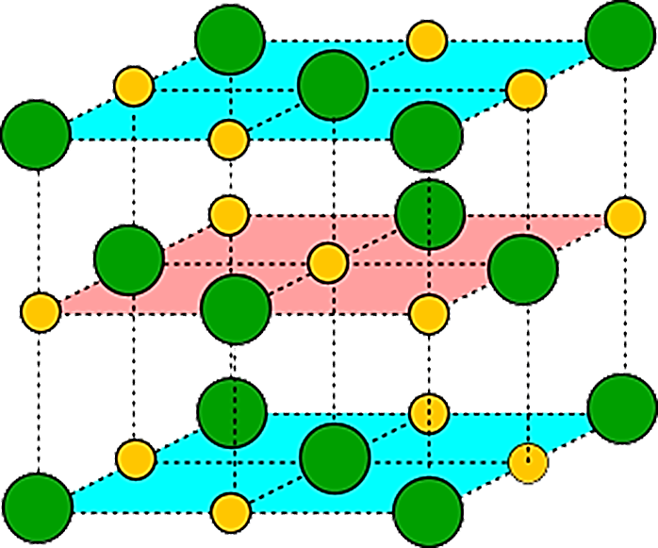
The lattice builds up in 3 dimensions
This is how crystals form

Slide 32
Physical properties of ionic compounds
Melting point
high A large amount of energy must be put in to overcome the
strong electrostatic attractions and separate the ions.
Strength
Very brittle Any dislocation leads to the layers moving and similar
ions being adjacent. The repulsion splits the crystal.
Electrical don’t conduct when solid - ions held strongly in the lattice
conduct when molten or in aqueous solution - the ions
become mobile and conduction takes place.
Solubility Insoluble in non-polar solvents but soluble in water
Water is a polar solvent and stabilises the separated ions.
Much energy is needed to overcome the electrostatic attraction and separate the ions. Stability attained by being surrounded by polar water molecules compensates for this

