Slide 1
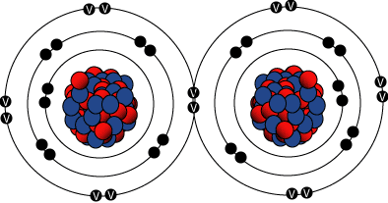
Covalent Bonding

Slide 2
4.2.1: Describe the covalent bond as the electrostatic attraction between a pair of electrons and positively charged nuclei.
4.2.2: Describe how the covalent bond is formed as a result of electron sharing.
4.2.3: Deduce the Lewis (electron dot) structures of molecules and ions for up to four pairs of electrons on each atom.
4.2.4: State and explain the relationship between the number of bonds, bond length, and bond strength.
4.2.5: Predict whether a compound of two elements would be covalent from the position of the elements in the periodic table or from their electronegativity values.

Slide 3
Covalent bonds occur between elements of high electronegativity
This means elements towards the right hand side of the periodic table
(sometimes towards the middle of the periodic table)
Note that if an element exists in a diatomic form, the bonding is always covalent!
E.g. H₂ ; N₂ ; O₂ ; Cl₂

Slide 4
Both atoms need to gain electrons in order to fill their valance shell (and become isoelectronic with a noble gas)
This is achieved by sharing one or more pairs of electrons.
Elements in compounds usually have 8 electrons in their outer shell – this is the “octet rule”
The “bonding force” between atoms is the electrostatic force between the shared electrons and the nucleus of each atom

Slide 5
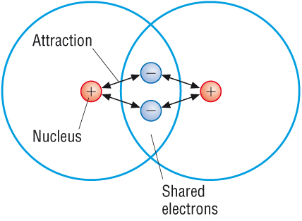

Slide 6
This attractive force is ONLY between a specific pair of atoms.
It does NOT act in all directions
There are weak intermolecular forces

Slide 7
We can represent covalent bonding in a number of ways:

Slide 8
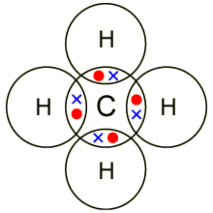
A dot and cross diagram:

Slide 9
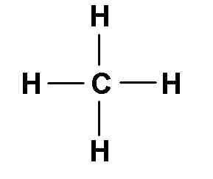
A structural formula:
Each line represents a PAIR of electrons

Slide 10
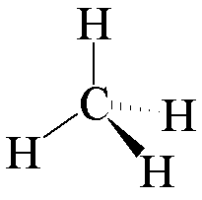
A 3-d representation
Molecules are not flat the way we usually draw them. In some topics we will need to show their shape.

Slide 11
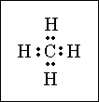
A Lewis Diagram

Slide 12
You probably can’t see the point of Lewis diagrams
BUT they are very important and the IB nearly always ask a question about them.
They show all the electrons in the valence shells of the atoms involved.
Pairs of electrons may be shown as a pair of dots, or as a line:

Slide 14
Lewis structures are useful for working out where double and triple bonds happen
And are very very very useful for working out the shapes of molecules!
You need to learn the rules for drawing Lewis diagrams:

Slide 15
Use the formula of a molecule, together with any charge on the molecule to calculate the total number of bonding electrons in a molecule.
Decide which molecule is to be placed central, and then draw a “skeleton” structure showing the atoms joined by single bonds. Subtract a pair of electrons for each single bond made.
Use the remaining electrons to fill the octets of as many atoms as possible – starting with the most electronegative atoms
If some atoms don’t have full octets, use non bonding electrons to make double bonds.

Slide 16
5. If necessary, calculate the formal charge for each atom using the formula
Charge = (valance electrons) – (1/2 bonding electrons) – (lone electrons)
Sometimes there may be more than one possible Lewis structure
This is something the HL students will have to worry about!

