Slide 1
Electron Arrangement

Slide 2
2.3 Electron arrangement
2.3.1 Describe the electromagnetic spectrum.
2.3.2 Distinguish between a continuous spectrum and a line spectrum.
2.3.3 Explain how the lines in the emission spectrum of hydrogen are related to electron energy levels.
2.3.4 Deduce the electron arrangement for atoms and ions up to Z=20.

Slide 4
Shinjuku by night
“The neon capital of the world”
How do neon lights work?
Why do different gases give out different colours?
We can use this information to begin building a picture of how electrons are arranged in atoms.
You may already know about how electrons are arranged (from IGCSE), but we can’t see electrons, so how do we know?

Slide 5
First we have to learn a little bit about light
Light is part of the electromagnetic spectrum.
This is energy given out by the sun (among other things!)
The electromagnetic spectrum is the full range of electromagnetic radiation.

Slide 6
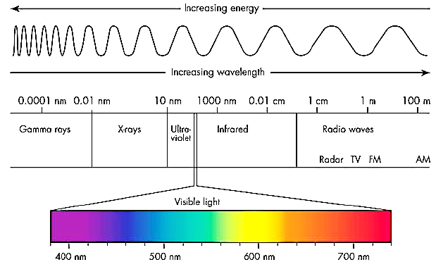

Slide 7
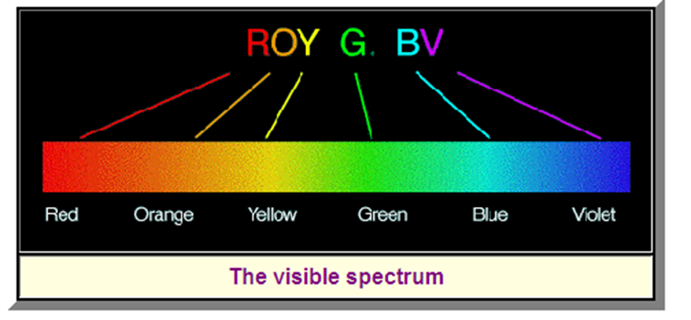
We only need to think about the visible spectrum. (For now!)
If we examine light from the sun, we see a continuous spectrum

Slide 8
This means that the spectrum shows all the frequencies of visible light
i.e. it contains all the colours, and has no gaps.
If we look at the spectrum from hydrogen gas
(we are using Hydrogen as an example because it is the simplest element)
We see something very different!

Slide 9
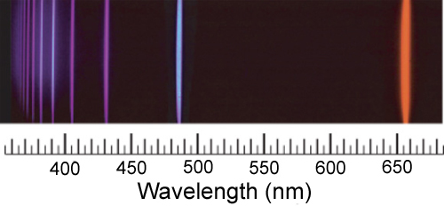
We see a line spectrum – a spectrum which only shows certain frequencies of visible light.

Slide 11
Hydrogen Emission Spectra Experiment – Experimental Observations
Energy added in the form of heat, electricity or light → only certain specific colors of light are emitted
Thus only specific energies are emitted

Slide 12
This presents us with a number of problems to explain:
How can an atom absorb or emit light energy?
Why is the energy absorbed or emitted only at specific frequencies?
We also have to explain why the electrons that are orbiting the nucleus don’t just crash into the nucleus (remember opposite charges attract)

Slide 13
The Bohr Model of an Atom
In order to explain the observations, we must place restrictions on exactly where the electrons may be.
The electrons are quantized.
I.e. they can only exist at certain specific energy values.
This is known as the Bohr model of an atom.

Slide 14
Postulates of Bohr model
Electrons can have only certain specific values of energy.
Electrons travel in fixed, circular orbits*
When an electron absorbs the exact difference in energy between 2 levels it makes a quantum leap up
When an electron makes a quantum leap down it releases the exact difference in energy between two levels.
* = we no longer believe this postulate

Slide 15
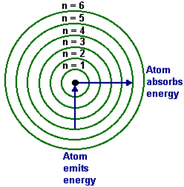

Slide 16
Hydrogen only has one electron so it is easy to visualise the changes in quantum level.
For the emission spectrum the electron drops quantum levels.
Light of one particular energy (frequency) is given out when an electron drops from n=2 to n=1.
More energy is given out when an electron drops from n=3 to n=1
So the light given out has a higher frequency
Further frequencies are given out for n=4 → n=1; n=5 → n=1 etc.

Slide 17
In practice the hydrogen spectrum is divided into a number of series.
These series are identical in form but occur at different frequencies.
The series we have discussed produces lines in the ultraviolet region of the spectrum.
This is because a transition to n=1 always releases a lot of energy.
It is known as the Lyman series.

Slide 18
A second series is produced for transitions to n=2 (i.e. n=3 → n=2 ; n=4 → n=2 etc.)
This is a lower energy spectrum
Why?
This series is called the Balmer series and is in the visible region of the E.M. Spectrum
The Paschen series is in the infrared region and is produced by electrons dropping back to the n=3 level

Slide 19
Hydrogen Atom and Emission
n = ...infinity
n = 4
n = 3
n = 2
n = 1
Balmer
Lyman
Paschen

Slide 21
Notice that the because the lines get closer at high frequency (low wavelength)
We can deduce that the quantum levels get closer at high energy levels

Slide 22
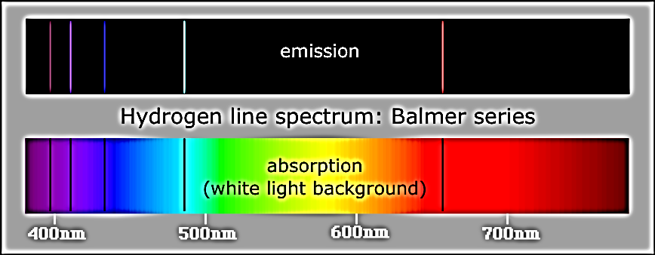
We can also have an absorption spectrum for hydrogen.
If white light is shone at hydrogen, only specific frequencies are absorbed.
These correspond to the frequencies given out in the emission spectrum

Slide 23
How can you explain this?

Slide 24
Electronic Structure for Atoms up to Z=20
The energy levels closer to the nucleus are more stable
So they tend to fill before energy levels further away.
There is a maximum number of electrons that each energy level can hold.
The first can hold 2 electrons
The second can hold 8 electrons

Slide 25
Beyond this it becomes more complicated
But the next 8 electrons go into the third energy level
The next 2 go into the fourth energy level.
Each energy level is called an orbital (or shell)
If a question asks for the electronic structure of an atom, we must give the number of electrons in each orbital.

Slide 26
E.g. what is the electronic structure of aluminium?
From the periodic table, Al has 13 protons
Therefore it has 13 electrons.
2 in the first orbital
8 in the second
And 3 in the third.
We can represent this by 2,8,3

Slide 27
The number of electrons an element has determines its chemical properties
In particular chemists are concerned with the outermost shell of electrons
The valence electrons.
The position of an element in the periodic table is closely related to its electronic structure.
The period (or row) tells us how many energy levels are occupied.
The group tells us how many electrons are in the valence shell.

Slide 28
E.g. Phosphorous is in Group 5 and the third period.
So it has 3 occupied shells
And the outer shell has 5 electrons.
SL candidates need to be able to give the electronic structure for the first 20 elements
This is exactly the same requirement as IGCSE

Slide 29
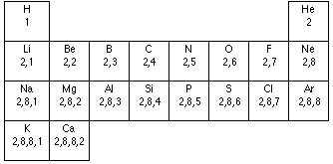

Slide 30
2.3 Electron arrangement
2.3.1 Describe the electromagnetic spectrum.
2.3.2 Distinguish between a continuous spectrum and a line spectrum.
2.3.3 Explain how the lines in the emission spectrum of hydrogen are related to electron energy levels.
2.3.4 Deduce the electron arrangement for atoms and ions up to Z=20.

