Slide 1
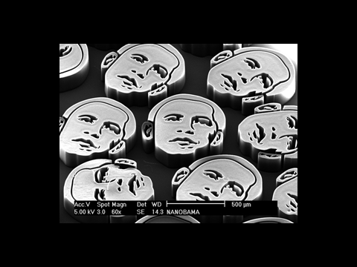
C7 - Nanotechnology

Slide 2
Syllabus statements
C.7.1 Define the term nanotechnology.
C.7.2 Distinguish between physical and chemical techniques in manipulating atoms to form molecules.
C.7.3 Describe the structure and properties of carbon nanotubes.
C.7.4 Discuss some of the implications of nanotechnology.

Slide 3
You should already know about
Fullerenes
Especially Buckminster – Fullerene
“Buckyballs”
Its also worthwhile reading up about graphene.
Lots of this is technology that is still being developed. There will be plenty of up to date stuff on the internet.
Be an independent learner and do some background reading.

Slide 4
C.7.1 Define the term nanotechnology.
Nanotechnology involves research and technology development at the 1nm to 100nm range.
1nm = 10⁻¹²m
Typically this is the size of a group of atoms
A small bacterium is about 200nm
DNA is about 2.5 nm wide
A human hair has a thickness of 100,000 nm

Slide 5
C.7.2 Distinguish between physical and chemical techniques in manipulating atoms to form molecules.
Physical techniques allow atoms to be manipulated and position according to specific requirements.
Examples include vaporizing metals and forming a layer 1 atom thick when the vapour is cooled.
And the use of a Scanning Tunnelling Microscope (STM) . . .

Slide 6
You don’t have to know this, but . . .
The scanning tunnelling microscope (STM) is a type of electron microscope that shows three-dimensional images of a sample. In the STM, the structure of a surface is studied using a stylus that scans the surface at a fixed distance from it.
An extremely fine conducting probe is held close to the sample. Electrons tunnel between the surface and the stylus, producing an electrical signal. The stylus is extremely sharp, the tip being formed by one single atom. It slowly scans across the surface at a distance of only an atom's diameter. The stylus is raised and lowered in order to keep the signal constant and maintain the distance. This enables it to follow even the smallest details of the surface it is scanning. Recording the vertical movement of the stylus makes it possible to study the structure of the surface atom by atom. A profile of the surface is created, and from that a computer-generated contour map of the surface is produced.

Slide 7
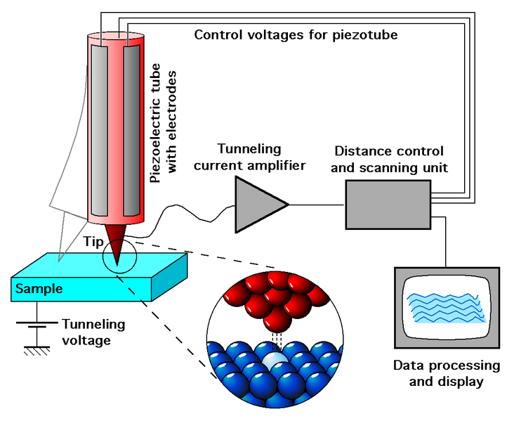

Slide 8
The voltage on the very fine tip (usually made of a platinum alloy) can be used to “pick up” and move polar molecules, or even radicals.
(I mention radicals for a reason:
The textbook uses the example of the platinum tip catalysing the fission of a H-H bond to give two hydrogen radicals.
The radicals can then be positioned to selectively add across a C=C double bond.
Why you would want to do this is another question!)

Slide 9
Chemical techniques position atoms using chemical reactions.
Eg. Enzyme – substrate reactions in biochemistry, or . . .
The chemical method provides the horizontal growth of nanowires from individual gold nanodroplets, and their alignment is dictated by lattice match with the underlying substrate. Locations of NWs, with a submicrometer precision, are controlled by the position of gold patterns made by photolithography. NWs are grown where the devices will be fabricated, and there is no need to transfer NWs to a different substrate. This approach in its current state seems to be a promising methodology for parallel nanodevice fabrication at technologically relevant scales.”

Slide 10
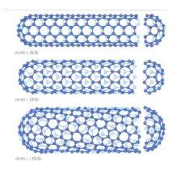
C.7.3 Describe the structure and properties of carbon nanotubes.

Slide 11
Nanotubes are hollow cylinders made of carbon atoms.
They are typically about 1 nm across.
They can be single walled or multi walled – 2 or more tubes inside each other.
The walls of the tubes have a hexagonal structure similar to that of graphite with covalent bonding
Test for HL students – what kind of hybridisation is present?
Each carbon forms 3 sigma bonds, so its SP2 hybridisation!

Slide 12
The covalent bonding means that nanotubes are very strong.
They are structurally rigid
The ends of the tubes are closed by curved caps.
To make the curved cap possible, it has to be made of a mixture of hexagons and pentagons.
(look at the panels on a football!)

Slide 13
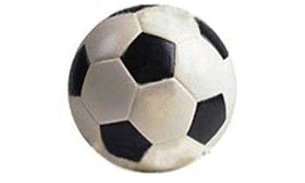

Slide 14
The pentagons present in the end caps have a different bond angle.
This affects their chemical properties and their physical properties.
They are more reactive than hexagons, and this reactivity allows particles of metals, metal oxides or metal salts to be inserted inside the nanotube.

Slide 15
The pentagons also have different conductivity to graphite.
Very thick nanotubes have mostly “wall” and not much “cap”
So they behave like graphite
Thinner tubes have less wall and more cap, so they behave less like graphite.
By changing the length, diameter and number of walls, nanotubes can be made to behave as conductors or semiconductors.

Slide 16
C.7.4 Discuss some of the implications of nanotechnology.
Possible uses of nanotechnology:
This is a developing field. Things change quickly.
One current use is to try to make electronic circuitry smaller (nanowires)
NT may also be useful in catalysis, very strong construction materials, invisible sunscreens, bacteriocidal bandages and clothing, new delivery systems for medicines, swimming pool cleaners, self cleaning glass.
Who knows what else! Try researching it yourself.

Slide 17
Possible concerns:
Health effects and toxicity have not yet been fully established.
The small size of nanoparticles means they can easily get into the body through inhalation or skin absorption.
We don’t yet know the risks of this. Can nanoparticles affect the genetic make up of cells? Can they cross the blood-brain barrier? Can they cause cancer?
Their properties are affected by size, shape surface area/volume ratio so the questions aren’t easy to answer.

Slide 18
Because nanotechnology doesn’t require heavy industry and large capital investment, there is potential for very rapid growth.
This could potentially lead to regulatory challenges as new industries develop.
Could relatively cheap nanotechnology reduce the rich-poor divide by supplying cheap consumables?
What are the military implications

Slide 19
Nanotechnology is an industry in its early stages.
It is not yet well understood
There is potential for a lot of money to be made by the right person
There is also potential for major problems
It will be the responsibility of your generation to oversee its development.

