Slide 1
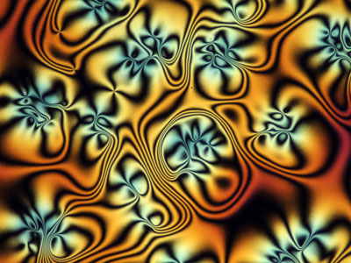
Liquid Crystals

Slide 2
Syllabus Statements
C.6.1 Describe the meaning of the term liquid crystals.
C.6.2 Distinguish between thermotropic and lyotropic liquid crystals
C.6.3 Describe the liquid-crystal state in terms of the arrangement of the molecules and explain thermotropic behaviour.
C.6.4 Outline the principles of the liquid crystal display device
C.6.5 Discuss the properties needed for a substance to be used in liquid-crystal displays

Slide 3
C.6.1 Describe the meaning of the term liquid crystals.
Liquid crystals are fluids that have physical properties (e.g. electrical, optical, elastic) that are dependent on the molecules orientation relative to some fixed axis.

Slide 4
In crystals, the molecules are fully oriented and fixed in position.
In an isotropic liquid the molecules are arranged completely randomly. The properties of the liquid are the same in all directions.
Liquid crystals lie between these extremes.
They are a mesophase.

Slide 5
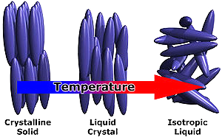

Slide 6
Smectic or nematic?
Smectic liquid crystals still have the molecules arranged in layers.
Individual molecules can move within layers, but are always roughly parallel.

Slide 7
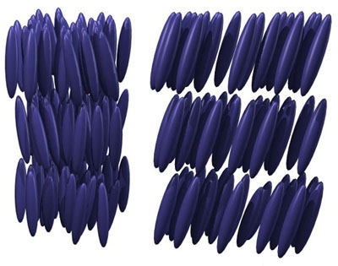
A smectic liquid crystal

Slide 8
A nematic liquid crystal doesn’t have layers.
On average the molecules point in the same direction

Slide 9
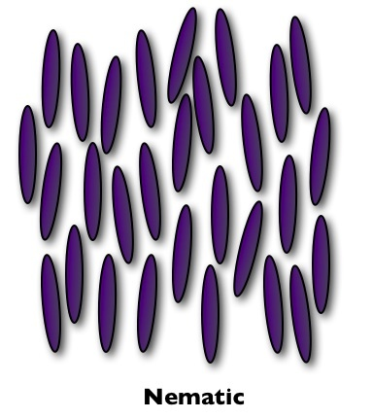
A nematic liquid crystal

Slide 10
You’ve probably spotted that liquid crystals tend to have rod shaped molecules.
These are usually elongated organic molecules.
Some common examples are DNA, spider silk, cellulose.
You need to be able to draw some examples

Slide 11
Another example:
MBBA
N-(4-Methoxybenzylidene)-4-butylaniline

Slide 12
C.6.2 Distinguish between thermotropic and lyotropic liquid crystals
Thermotropic liquid crystals are pure substances that exhibit L.C. behaviour over a temperature range between solids and liquids.
Note that by implication, substances that show L.C. behaviour are not always in the correct phase to show L.C. behaviour.
Some specific examples are:

Slide 13
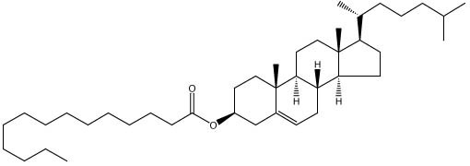
Cholesterol Myristate
Solid below 71°C ; Clear liquid above 86°C
In between, it is a cloudy liquid – a liquid crystal

Slide 14
Biphenyl nitriles (a family of molecules!)
“5CB”
Real name 4-cyano-4-n-pentylbiphenyl
Crystalline solid below 18°C
Isotropic liquid above 36°C
Liquid crystal between these two temperatures
The temperature at which it exhibits L.C. behaviour can be altered by changing the hydrocarbon tail

Slide 15
Lyotropic liquid crystals are not pure substances.
They are solutions that show liquid crystal properties at certain concentrations

Slide 16
For example a solution of soap in water displays liquid crystal properties at concentrations above a certain value
Typically this concentration is “a few percent” soap!
At these concentrations micelles form.
These are when the hyrophobic tails of the soap molecules all point inwards away from the water
And the hydrophilic (polar) heads point outwards and interact with the water.

Slide 17
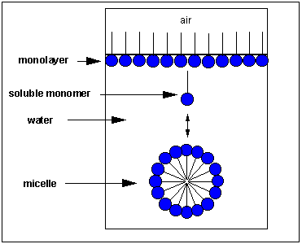

Slide 18
C.6.3 Describe the liquid-crystal state in terms of the arrangement of the molecules and explain thermotropic behaviour.
In a solid crystal the molecules are fixed in position and in direction.
They are held by strong forces.
If the individual molecules in the crystal are not symetrical (e.g. they are rod shaped – like the L.C. molecules we have looked at)
Then the forces holding the molecules are not the same in all directions.

Slide 19
As the crystal is heated, the weak forces are overcome first.
This disrupts the order of the crystal in one direction, but the strong forces still haven’t been overcome,
So the molecules still have order in other directions
In smectic L.C.s the strong forces keep the molecules in layers, but the weak forces are overcome
Meaning the molecules can move within layers, so the molecules are only roughly parallel

Slide 20
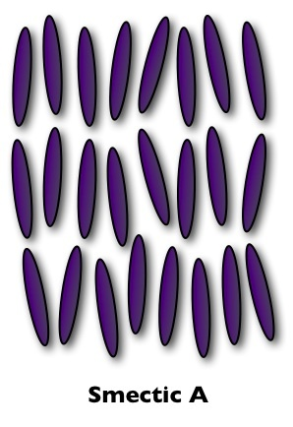

Slide 21
If the crystal is heated further, the molecules gain enough energy to break the layer structure
But ON AVERAGE still all point in the same direction.
This is a nematic L.C.
Nematic L.C.s are used in LCDs

Slide 23
Heating the crystal further, completely breaks down the order and gives an isotropic liquid.
(a “normal” liquid)

Slide 24
C.6.4 Outline the principles of the liquid crystal display device
Ordinary unpolarized light consists of an electrical field vibrating in all direction.
Passing the light through a polarizer only allows light vibrating on one particular direction to pass through.

Slide 25
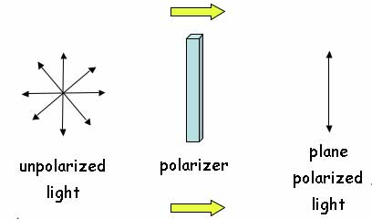

Slide 26
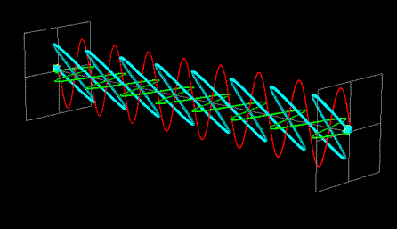
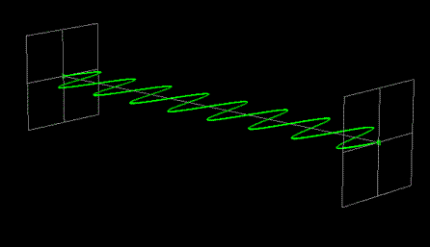

Slide 27
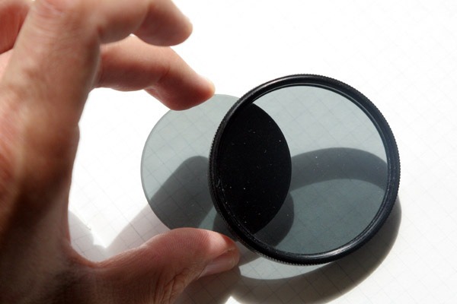
If a second “crossed” polarizing filter is introduced, no light can pass through

Slide 28
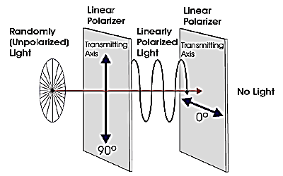

Slide 29
Liquid crystals can rotate the direction or plane of polarized light.
If a correctly aligned layer of liquid crystal is placed between the crossed polarizing filters, then the polarized light is rotated through the correct angle to pass through the second filter.
If the L.C. molecule is polar, then its orientation can be controlled by applying a small voltage across it.
Using this technique areas of light and dark can be produced.

Slide 30
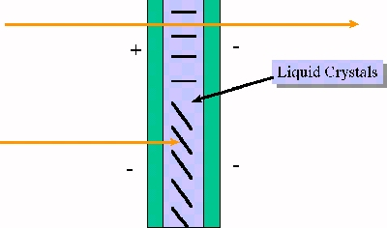

Slide 31
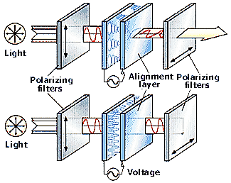

Slide 32
C.6.5 Discuss the properties needed for a substance to be used in liquid-crystal displays
In order to be useful in liquid crystal displays, molecules need to have certain properties.
They must be chemically stable, and not decompose or react.
They must behave as liquid crystals over a suitable range of temperatures (typically -10°C to +60°C)
They must be polar (or else we can’t make them change direction)
They must be able to change orientation quickly when a voltage is applied, and change back quickly when the voltage is removed. This is known as “switching speed”

Slide 33
Review of Syllabus Statements
C.6.1 Describe the meaning of the term liquid crystals.
C.6.2 Distinguish between thermotropic and lyotropic liquid crystals
C.6.3 Describe the liquid-crystal state in terms of the arrangement of the molecules and explain thermotropic behaviour.
C.6.4 Outline the principles of the liquid crystal display device
C.6.5 Discuss the properties needed for a substance to be used in liquid-crystal displays

